Slide 1

CEIS110 Project
Developing and Analyzing a Local Weather Information Data Base
By Teyvone Wells

Slide 2

Design and Library Setup

Slide 3
Flowchart
START
Install Python
Download weather data to a database.
Extract weather data from database into a comma separated file with python
Cleanse weather data
Use Excel to manipulate data
Use Excel to manipulate data
END

Slide 4
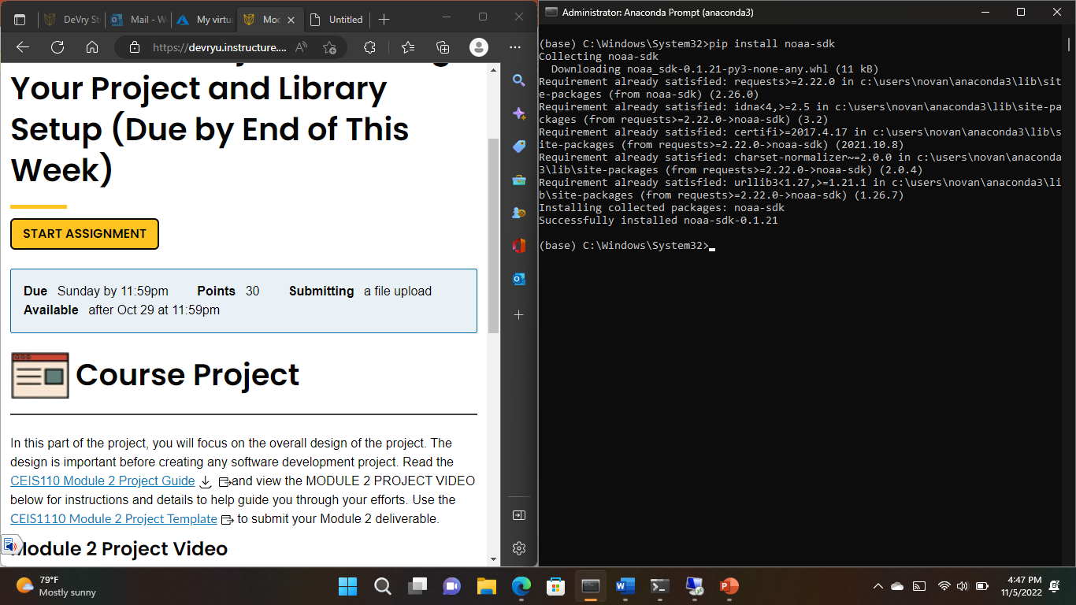
Software Inventory
Screenshot of NOAA-SDK library installed
"Successfully installed noaa-sdk" of pip install command is visible in the screenshot.

Slide 5
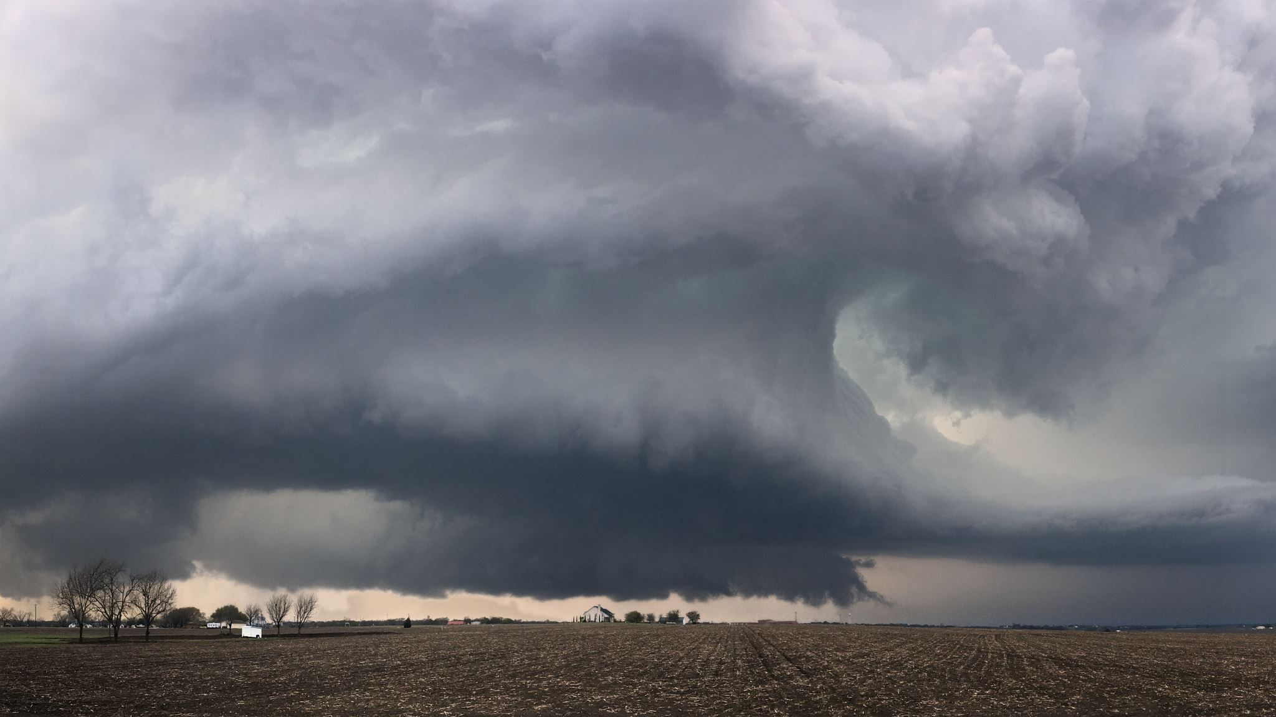
Downloading Weather Data

Slide 6
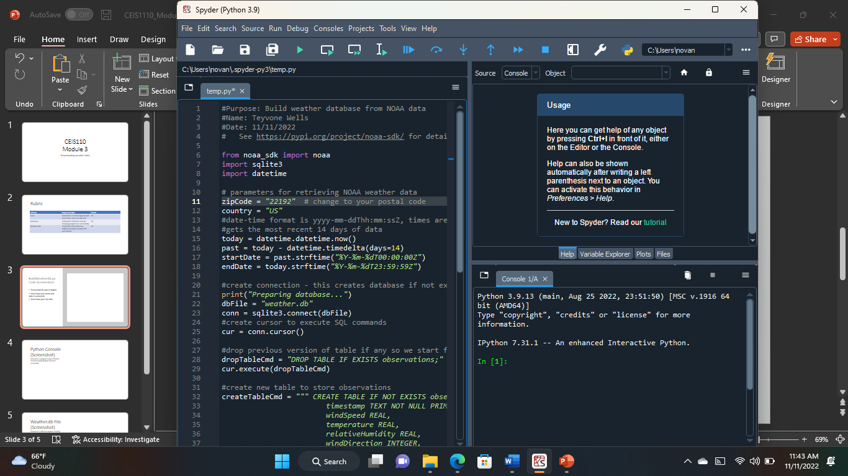
BuildWeatherDb.py Code
Screenshot of code in Spyder

Slide 7
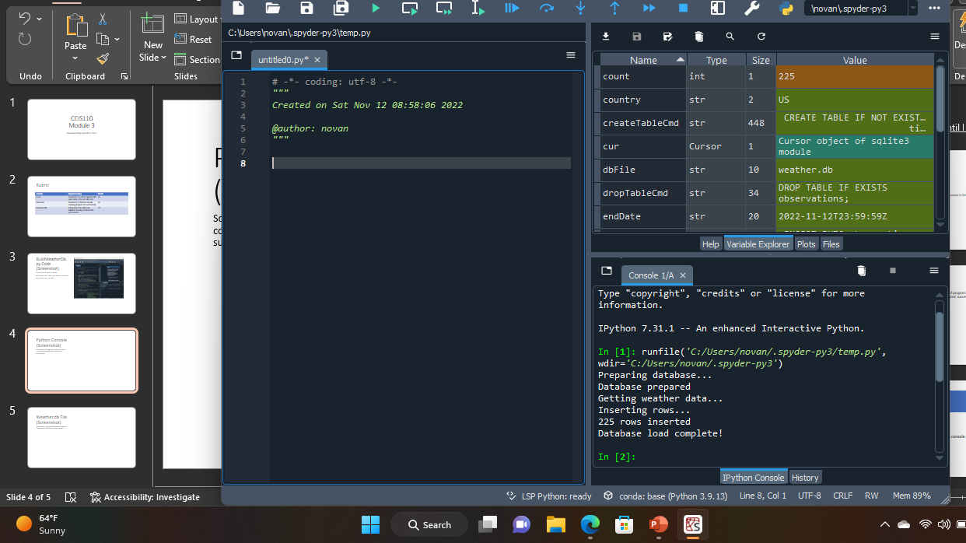
Python Console
Screenshot of program output in Python console showing program executed successfully

Slide 8
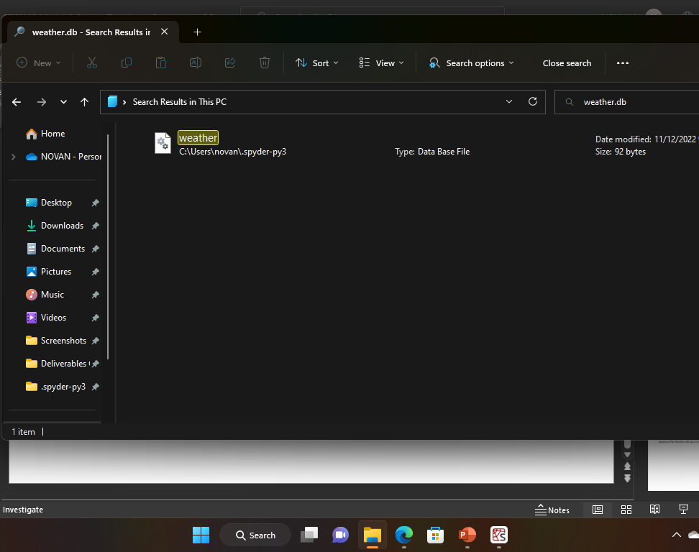
Weather.db File

Slide 9

Querying the database with SQL

Slide 10
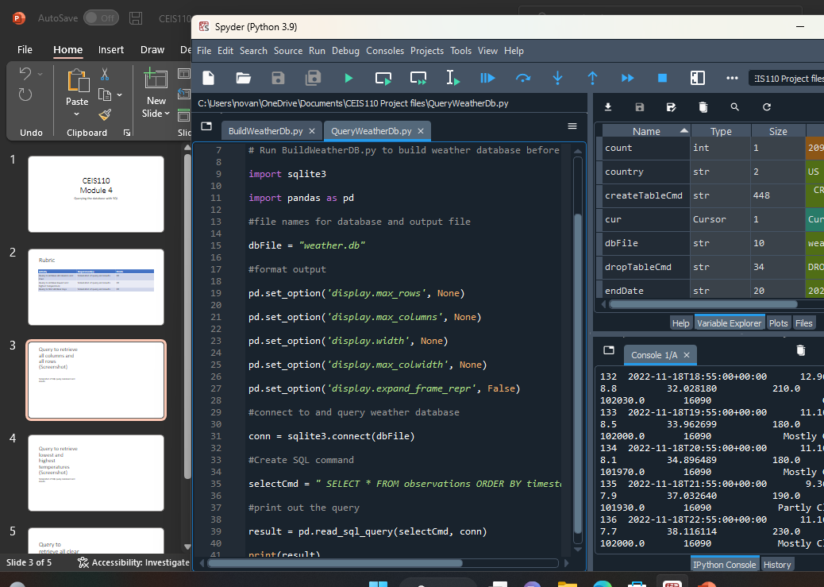
Query to retrieve all columns and all rows

Slide 11
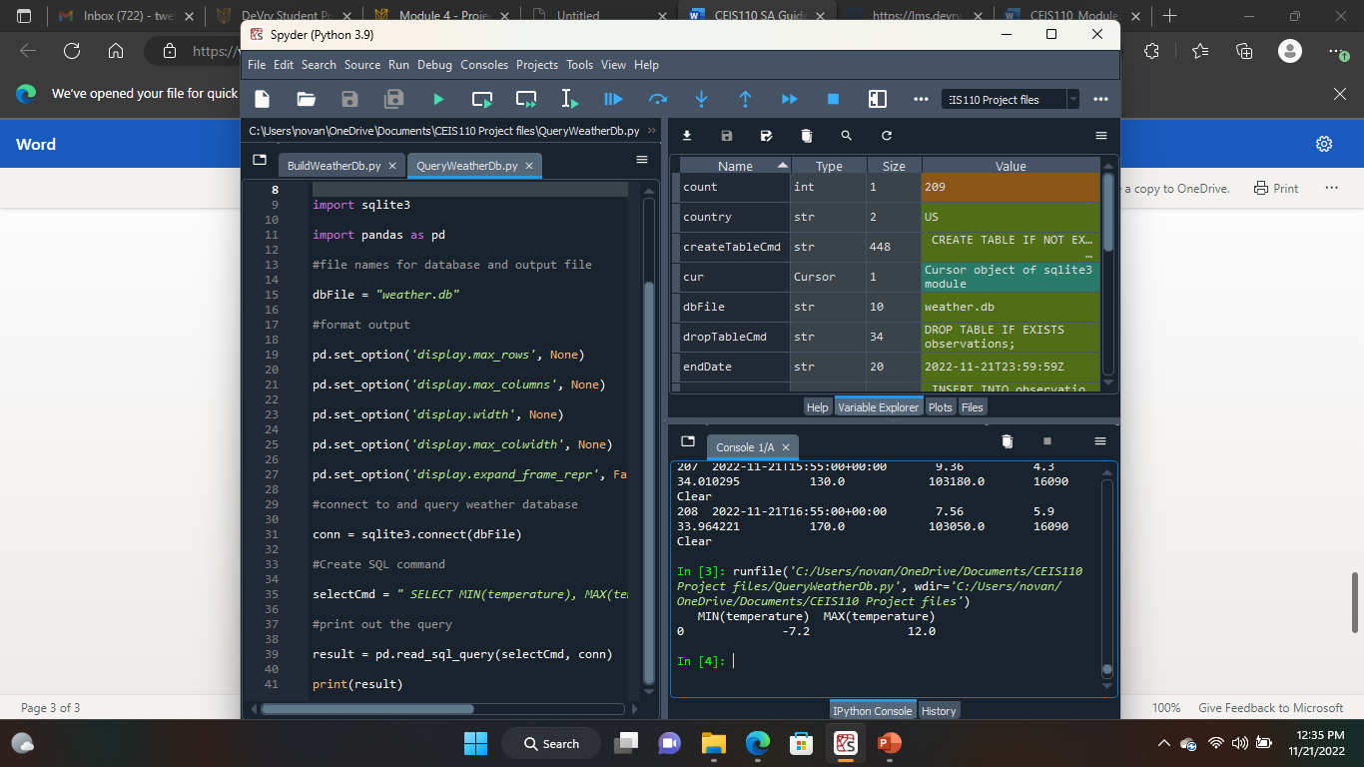
Query to retrieve lowest and highest temperatures

Slide 12
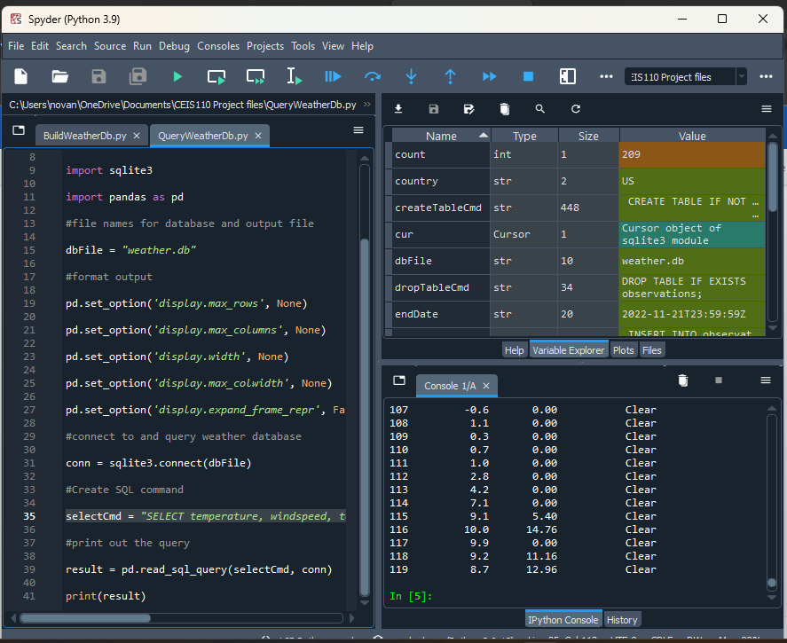
Query to retrieve all clear days

Slide 13

Querying and manipulating data with SQL and Python

Slide 14
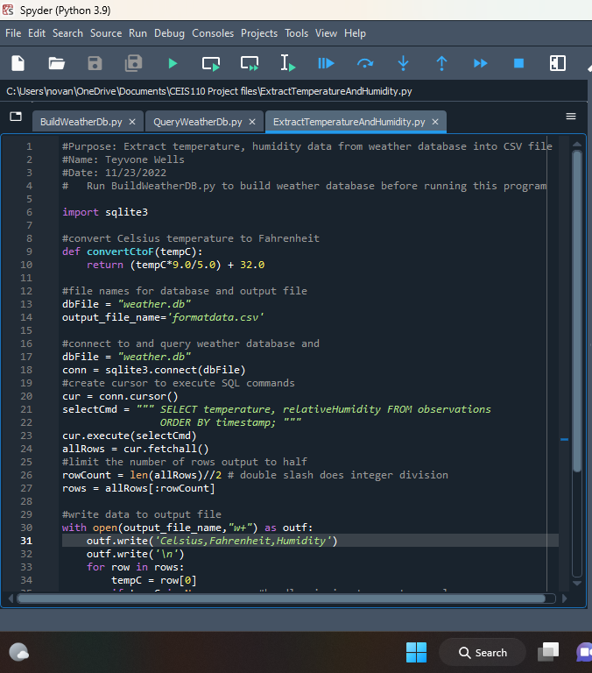
Python code
ExtractTempHumidity.py Python code

Slide 15
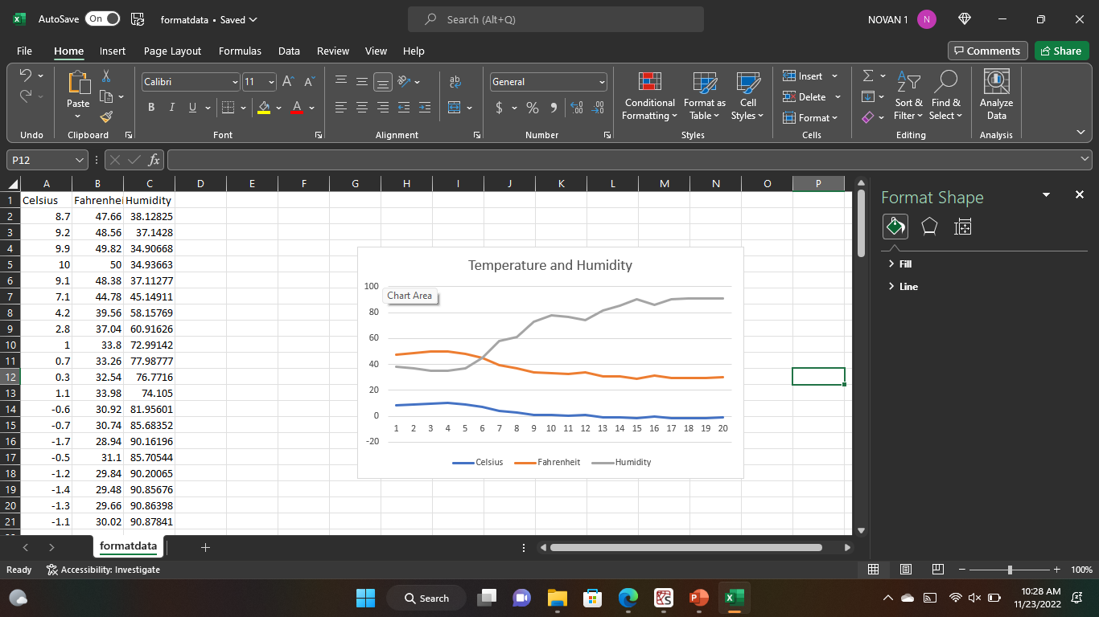
Retrieve and Convert Data to CSV Format
Formatdata file open in Excel showing 3 columns of data

Slide 16
Temperature and Humidity Chart
Excel chart based on temperature and humidity data from database

Slide 17

Develop Graphical Models and Interpret Results

Slide 18
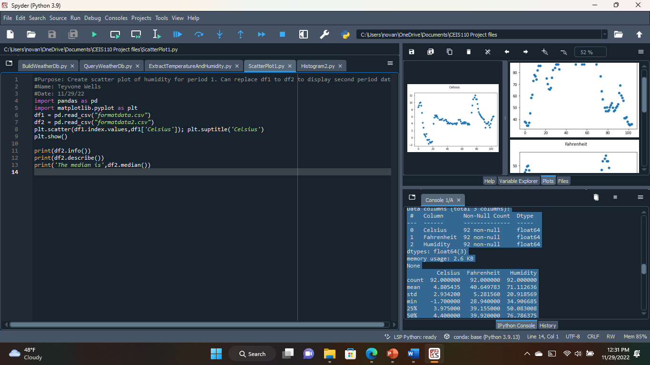
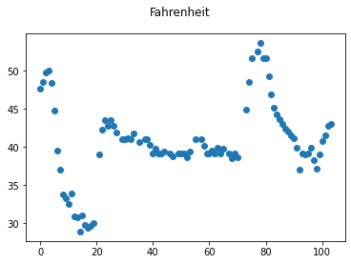
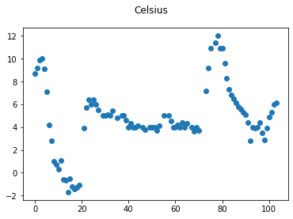
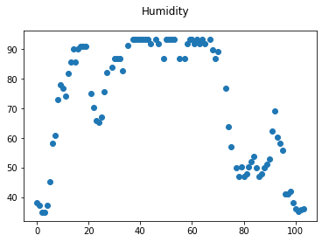
ScatterPlot
Celsius Fahrenheit Humidity
count 92.000000 92.000000 92.000000
mean 4.805435 40.649783 71.112636
std 2.934200 5.281560 20.918569
min -1.700000 28.940000 34.906685
25% 3.975000 39.155000 50.083008
50% 4.400000 39.920000 76.786375
75% 6.000000 42.800000 91.434944
max 12.000000 53.600000 93.248095
0 Celsius 92 non-null float64
1 Fahrenheit 92 non-null float64
2 Humidity 92 non-null float64
The median is Celsius: 4.400000
Fahrenheit: 39.920000
Humidity: 76.786375
dtype: float64

Slide 19
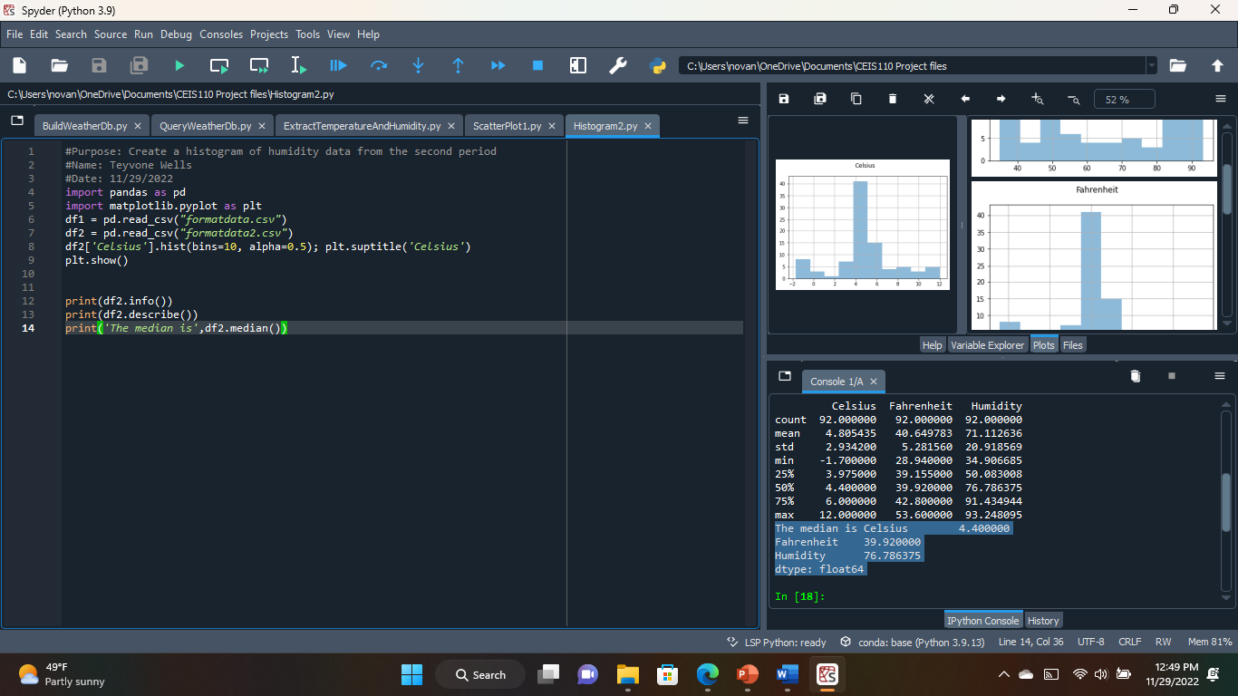
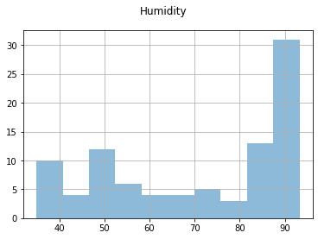
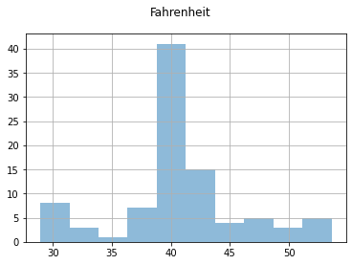
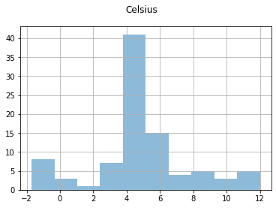
Histogram
Celsius Fahrenheit Humidity
count 92.000000 92.000000 92.000000
mean 4.805435 40.649783 71.112636
std 2.934200 5.281560 20.918569
min -1.700000 28.940000 34.906685
25% 3.975000 39.155000 50.083008
50% 4.400000 39.920000 76.786375
75% 6.000000 42.800000 91.434944
max 12.000000 53.600000 93.248095
0 Celsius 92 non-null float64
1 Fahrenheit 92 non-null float64
2 Humidity 92 non-null float64
The median is
Celsius: 4.400000
Fahrenheit: 39.920000
Humidity: 76.786375
dtype: float64

Slide 20


Analysis
Question:
What can be concluded about weather in the state of Virginia in November of 2022?
Answer supported by Chart:
The weather is composed of cool temperatures with high humidity. The chart shows that over 90 days leading into November there is an unexpected increase in temperature, leading to more moisture being evaporated from the previously cooled atmosphere.
The Humidity chart displays the increase in humidity approaching the end of a 90 day period in mid November
The Fahrenheit Chart displays the sudden increase in temperature within a 2-week period.

Slide 21

Prediction
Today (11/29/2022) in-particular is a little warmer outside than it has been the past week and certainly over the past few hours (Currently Noon). One can assume the humidity level would display another sudden increase when charted, and I can predict that the humidity would drop once again once the sun goes down and the wind picks up in support of that forementioned chart. I can imagine that the hours leading up to the sun falling low, the humidity would remain just around where it is currently plateaued (If not increased from constant increased temperature for periods of time).

Slide 22
Conclusion
The weather had drastically cooled over the weeks of completing this project. My prediction had been incorrect, yet the details explaining my prediction were accurate. There has been almost no humidity locally being that there has been such drastic drops in temperature even during the daytime. Many days have been cloudy without rain but coincidentally it rained the night before completing this project and snow has been forecasted for later in the week.

Slide 23
Challenges
I had encountered a couple issues completing my project, but nothing a little help from Prof. Wang couldn’t fix. I originally believed that I had been taking things step by step carefully and that I wouldn’t have much trouble. It was as I continued through the project that I started having issues. It was difficult for me to troubleshoot these issues on my own being that I was so sure I was doing each step correctly. It was when I contacted Prof. Wang for help that I had it brought to my attention that I had skipped a small yet very significant step in assembling my queries. In fixing this issue I had realized just how vital each detail is and how each file depends on the last file’s configuration.

Slide 24

Career Skills Obtained
This entire project has been non-stop learning from beginning to end. It started with completing my course work and learning what Python is, how it’s used, and how important it is globally. In learning how to speak to machines there comes a great deal of capabilities. For instance, completing this project has taught me how to use Python programming language on Spyder to develop a Weather Information Database then query the accumulated data for storage. This type of knowledge can be the most beneficial for those with intent to get into the Data Analytics field.

